Slide 1
SOCIAL MEDIA INFLUNCER IMPACT PREDICTION

Slide 2
1. Sanjay kumar(99220040190)
2. Ravi kumar(99220040181)
3. Gopal kumar(99220040063)
4. A.Lokesh(99220040236)

Slide 3
WHAT IS SOCIAL MEDIA INFLUNCER
A social media influencer is an individual who has established credibility and a large and engaged following on one or more social media platforms. These influencers have the ability to impact the opinions, attitudes, and purchasing decisions of their followers due to their perceived expertise, authenticity, and relatability within a particular niche or industry. Social media influencers are often seen as thought leaders or trendsetters in their respective areas.

Slide 4
Abstract
Predicting social media influencers involves using data analysis and machine learning to identify individuals who have the potential to become influential on platforms like Instagram, YouTube, or TikTok. We consider factors like follower count, engagement, content quality, posting consistency, and personality to make these predictions. By using machine learning models, we assign predictive scores to potential influencers, allowing brands and individuals to make informed decisions for their social media strategies. This process is dynamic and continuously monitored, as influencers' potential can change over time. In this presentation, we'll explore the methods and benefits of predicting social media influencers with real-life case studies.

Slide 5
TYPES OF INFLUENCERS
1.Mega-influencers(1M+ followers):- While mega-influencers offer incredible reach, studies have found that the rate of engagement decreases as the influencer’s total follower count rises. For Instagram influencers with more than 10 million followers, the engagement rate is only.
1.6 percent.
2.Macro-influencers(100k-1M followers):- Macro-influencer content is typically more professional-looking than what brands find with micro- or nano-influencers. Some brands may find this to be a better fit for their audience and goals.
3.micro-influencers(1k-100k followers):- Content from micro-influencers is less polished but may feel more authentic than content from macro- or mega-influencers. This may influence the amount of success a brand experiences with influencers marketing, depending on business goals.
4.nano-influencers(<1k followers):- Nano-influencers are much more cost-effective than their higher-ups, so brands with limited resources may want to start at this level of influencer marketing. Some nano-influencers don’t even charge brands, as they are building their following and partnerships with brands.

Slide 6
Flow of Social Media Influencer Prediction
1. Data Collection
- Gather data on potential influencers, including follower count, engagement metrics, posting frequency, and content quality.
2. Data Analysis
- Analyze the collected data to identify patterns and trends.
3. Feature Selection
- Choose relevant factors, such as follower count, engagement rate, and niche, to use in the prediction model.
4. Machine Learning Model
- Build a predictive model using machine learning algorithms.

Slide 7
5. Predictive Scoring
- Assign predictive scores to potential influencers based on the model's analysis.
6. Refinement and Monitoring
- Continuously update and refine predictions as influencers' data and performance change over time.
7. Case Studies
- Present case studies to showcase the accuracy and effectiveness of the prediction model.

Slide 8
Key characteristics of social media influencers
1.Large and Engaged Following: Influencers typically have a significant number of followers on platforms like Instagram, YouTube, TikTok, Twitter, or Facebook. The size of their following can vary widely, but what's crucial is the level of engagement and interaction they have with their audience.
2.Authenticity: Many successful influencers are known for their authenticity and transparency. They build trust with their followers by being genuine, relatable, and honest in their content.
3.Content Creation: Influencers regularly create and share content that resonates with their audience. This content can include posts, videos, photos, blog articles, and more. The quality and creativity of their content are key to their success.
4.Influence and Impact: Influencers have the power to influence the opinions, behaviors, and purchasing decisions of their followers. Brands often collaborate with influencers to promote products, services, or causes to their target audience.

Slide 9
Role of social media influencer
Influencers play a pivotal role in social media marketing by acting as intermediaries between brands and their target audience. Their role involves several key aspects:
Content Creation: Influencers are skilled content creators. They produce high-quality and engaging content, whether it's in the form of Instagram posts, YouTube videos, tweets, or blog articles. This content is often tailored to resonate with their specific niche or audience.
Audience Engagement: One of the central roles of influencers is to engage with their followers. They respond to comments, answer questions, and facilitate discussions, creating a sense of community and trust.
Authentic Recommendations: Influencers provide authentic recommendations and reviews of products or services. Their followers trust their opinions and are more likely to consider a purchase based on an influencer's endorsement

Slide 10
THE BUSINESS SIDE
Today, more than 3.23 billion individuals use social media across the globe. Whether it is for business or personal reasons, it’s become a major part of the lives of billions of people worldwide.
According to Emarketer, in 2019, 90.4% of Millennials, 77.5% of Generation X, and 48.2% of Baby Boomers were active social media users. But with all of these users ranging across a wide variety of ages, I wondered who, out of these different generations, were using social media for business purposes? Fortunately, I’ve been interning at a digital marketing agency for the last couple of months. So, I got the go-ahead to conduct a study to see what I could learn.
My study was conducted over the course of three months starting with a survey and now the analysis with responses. The objective was simple: to understand how each generation uses social media and what it will take to get each generation to use social media more regularly for business purposes. The target group included 18-50-year-olds, women or men, in the United States, mainly West and East Coast .

Slide 11
CASE STUDY
*.About 70% of people between the ages of 18 and 29 use Instagram, and it’s hard to spend much time scrolling without encountering a sponsored post from an influencer. The same holds true for just about any other social media platform.
*.New research from the University of Washington examines how factors related to influencers, their posts and their followers impact marketing success. Social media influencers are typically digital creators who have built a large following due to their knowledge on specific topics, such as beauty products, food or pets.
*.Recently published online and forthcoming in the Journal of Marketing, the study is one of the first to include cost data in its examinations of influencer marketing. Researchers found that if firms spent 1% more on influencer marketing, they would see a nearly 0.5% increase in engagement. They also concluded that reallocating spending based on the study’s insights could result in a 16.6% increase in engagement.
*.Engagement is the way people react to online content, such as such as liking, commenting or reposting. For this study, researchers prioritized the number of reposts because it represents a deep form of engagement where followers are choosing to share content with their own networks.

Slide 12
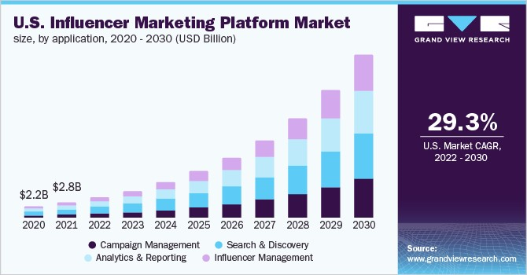
MARKET TENDS IN FUTURE

Slide 13
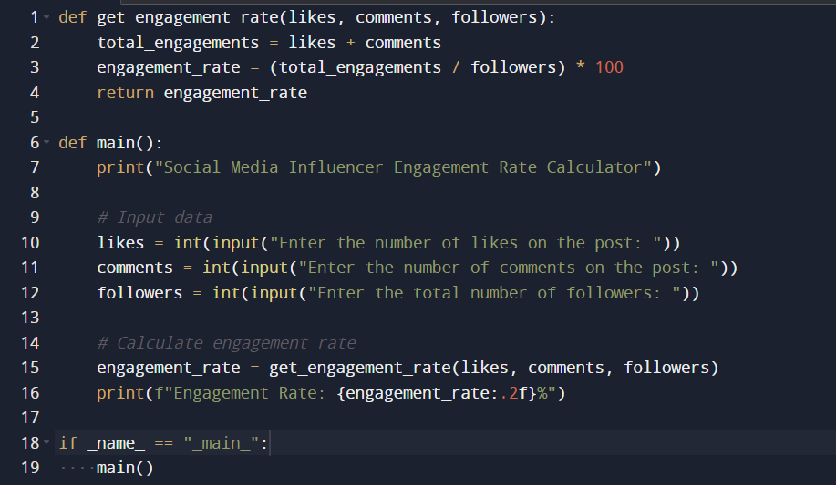
PYTHON PROGRAM

Slide 14
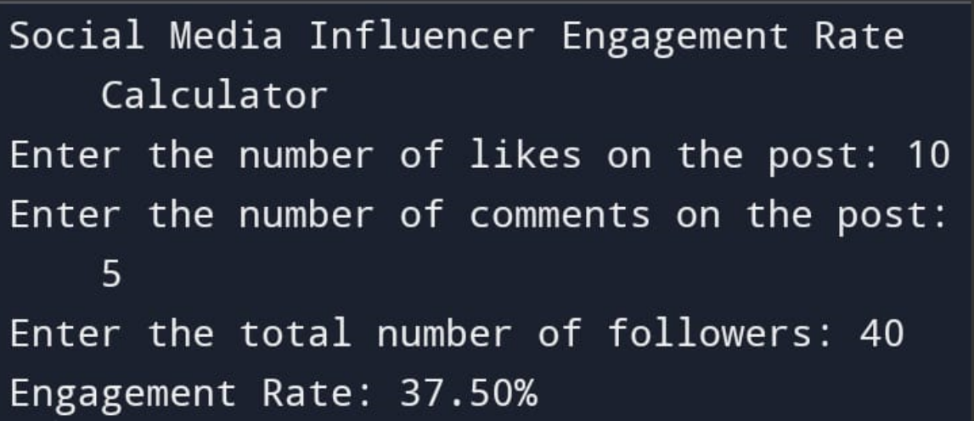
OUTPUT

Slide 15
THANK YOU

